Slide 1
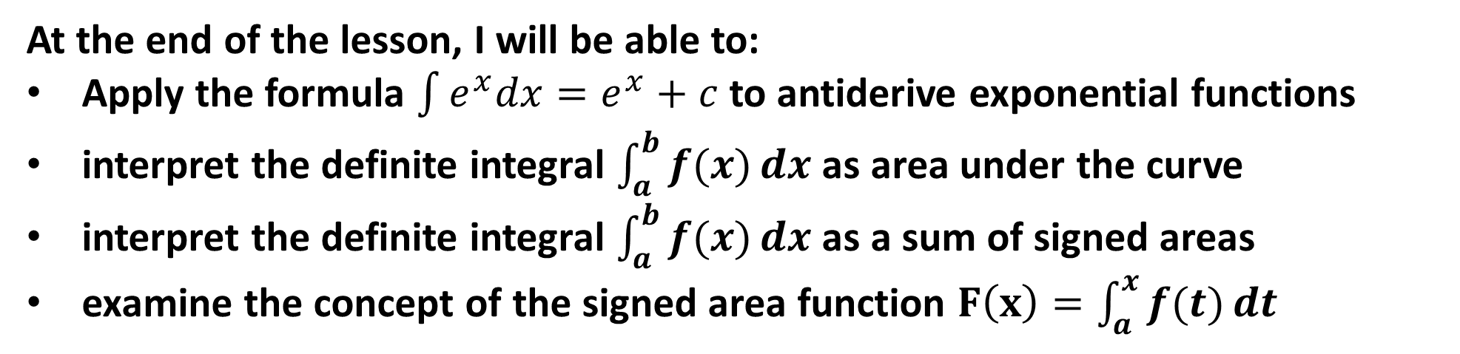
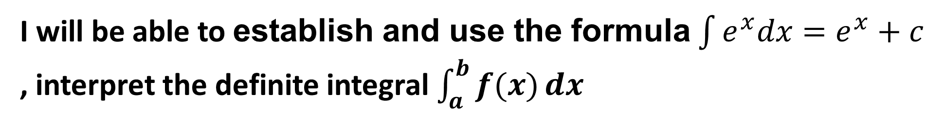
Learning Objective
I will be able to establish and use the formula $\int{e^{x}dx}=e^{x}+c$
, interpret the definite integral $\int_{a}^{b}{f(x)}dx$
Success Criteria
At the end of the lesson, I will be able to:
Apply the formula $\int{e^{x}dx}=e^{x}+c$ to antiderive exponential functions
interpret the definite integral $\int_{a}^{b}{f(x)}dx$ as area under the curve
interpret the definite integral $\int_{a}^{b}{f(x)}dx$ as a sum of signed areas
examine the concept of the signed area function $F\left(x\right)=\int_{a}^{x}{f(t)}dt$

Slide 2
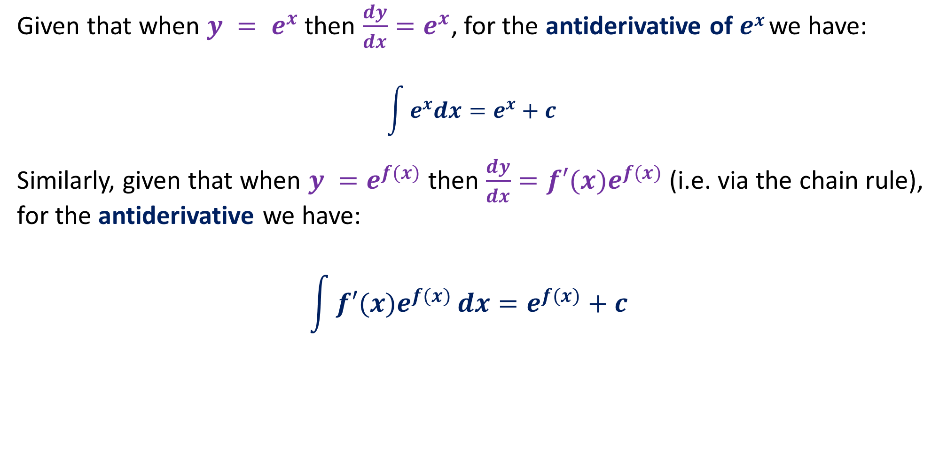
Integrating Exponential Functions
Given that when $y = e^{x}$then $\frac{dy}{dx}=e^{x}$, for the antiderivative of $ex$ we have:
$$\int{e^{x}dx}=e^{x}+c$$
Similarly, given that when $y =e^{f(x)}$ then $\frac{dy}{dx}={f′(x)e}^{f(x)}$ (i.e. via the chain rule), for the antiderivative we have:
$$\int{{f′(x)e}^{f(x)}}dx=e^{f(x)}+c$$

Slide 3
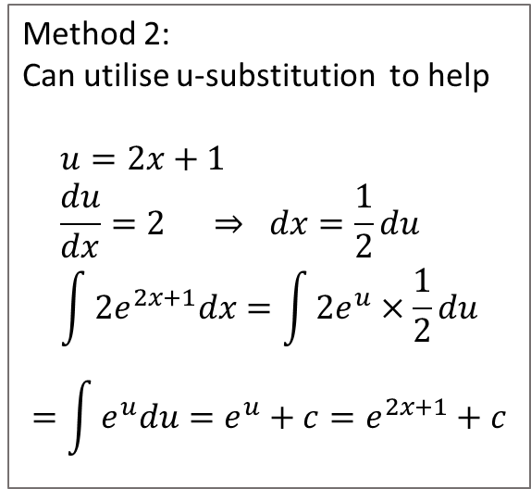
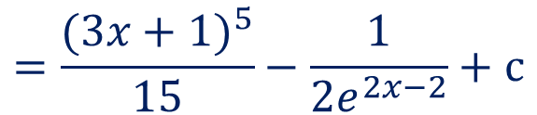
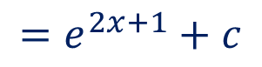
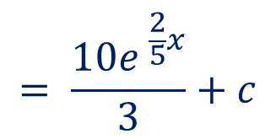
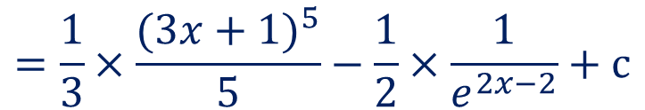
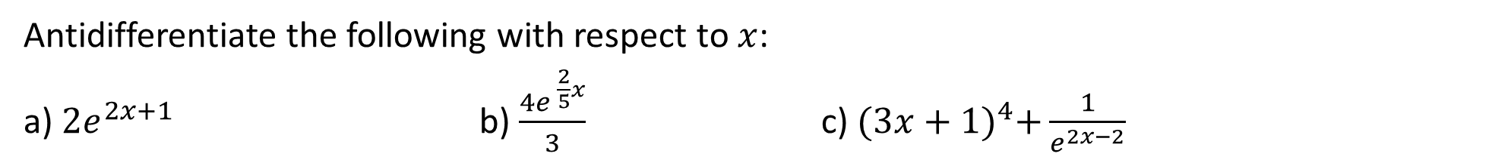
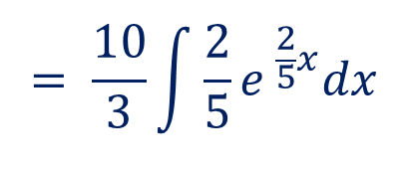
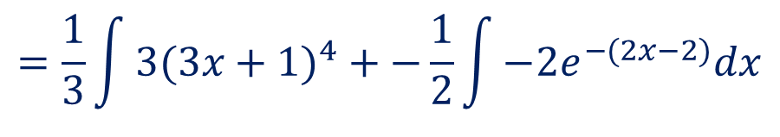
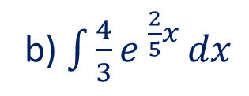
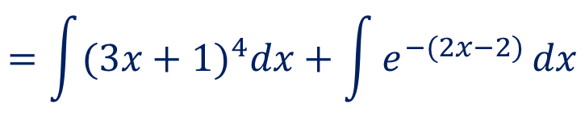
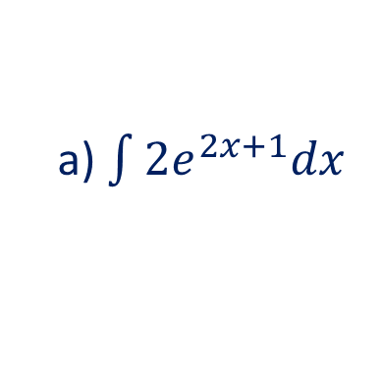
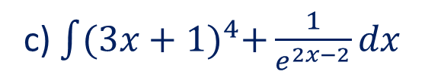
Guided practice
Antidifferentiate the following with respect to $x$:
a) $2e^{2x+1}$ b) $\frac{4e^{ \frac{2}{5}x}}{3}$ c) ${(3x+1)}^{4}+\frac{1}{e^{2x−2}}$
Method 2:
Can utilise u-substitution to help
$$u=2x+1 \\ \frac{du}{dx}=2 ⇒ dx=\frac{1}{2}du \\ \int{2e^{2x+1}dx}=\int{2e^{u}×\frac{1}{2}du}$$
$$=\int{e^{u}du}=e^{u}+c=e^{2x+1}+c$$
c) $\int{{(3x+1)}^{4}+\frac{1}{e^{2x−2}}dx}$
a) $\int{2e^{2x+1}dx}$
$$=e^{2x+1}+c$$
$$=\int{(3x+1)^{4}dx+\int{e^{−(2x−2)}}}dx$$
$$=\frac{1}{3}\int{3(3x+1)^{4}+−\frac{1}{2}\int{−2e^{−(2x−2)}dx}}$$
b) $\int{\frac{4}{3}e^{ \frac{2}{5}x}}dx$
$$= \frac{10}{3}\int{\frac{2}{5}e^{ \frac{2}{5}x}dx}$$
$$=\frac{1}{3}×\frac{(3x+1)^{5}}{5}−\frac{1}{2}×\frac{1}{e^{2x−2}}+c$$
$$= \frac{10e^{ \frac{2}{5}x}}{3}+c$$
$$=\frac{(3x+1)^{5}}{15}−\frac{1}{2e^{2x−2}}+c$$

Slide 4
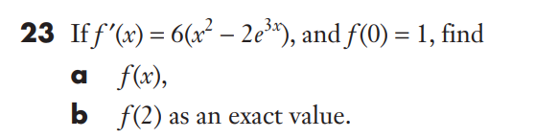

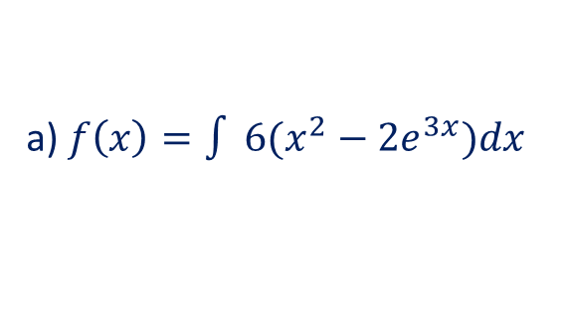
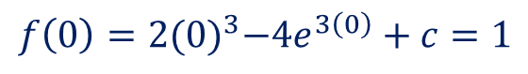


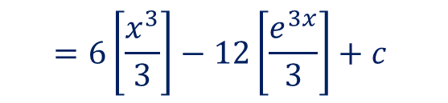

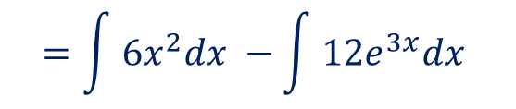

Guided practice
a) $f\left(x\right)=\int{ 6(x^{2}−2e^{3x})dx }$
$$=\int{ 6x^{2}dx }−\int{ 12e^{3x}dx }$$
$$=6\left[\frac{x^{3}}{3}\right]−12\left[\frac{e^{3x}}{3}\right]+c$$
$$=2x^{3}−4e^{3x}+c$$
$$f\left(0\right)=2{(0)}^{3}−4e^{3\left(0\right)}+c=1$$
$$c=1+4=5$$
$$f\left(x\right)=2x^{3}−4e^{3x}+5$$
$$f\left(2\right)=2{(2)}^{3}−4e^{3(2)}+5$$
$$=21−4e^{6}$$

Slide 5
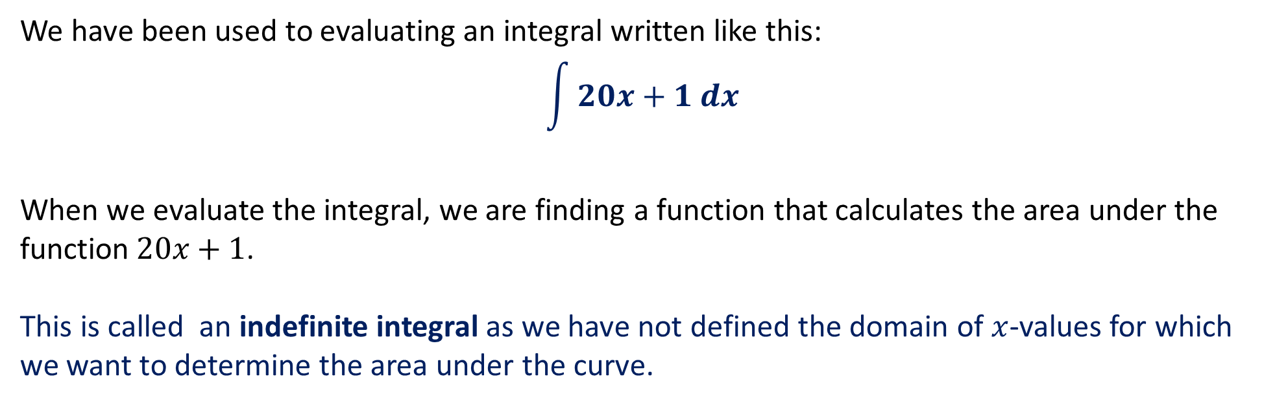
Indefinite Integrals
We have been used to evaluating an integral written like this:
$$\int{20x+1 dx}$$
When we evaluate the integral, we are finding a function that calculates the area under the function$20x+1$.
This is called an indefinite integral as we have not defined the domain of $x$-values for which we want to determine the area under the curve.

Slide 6
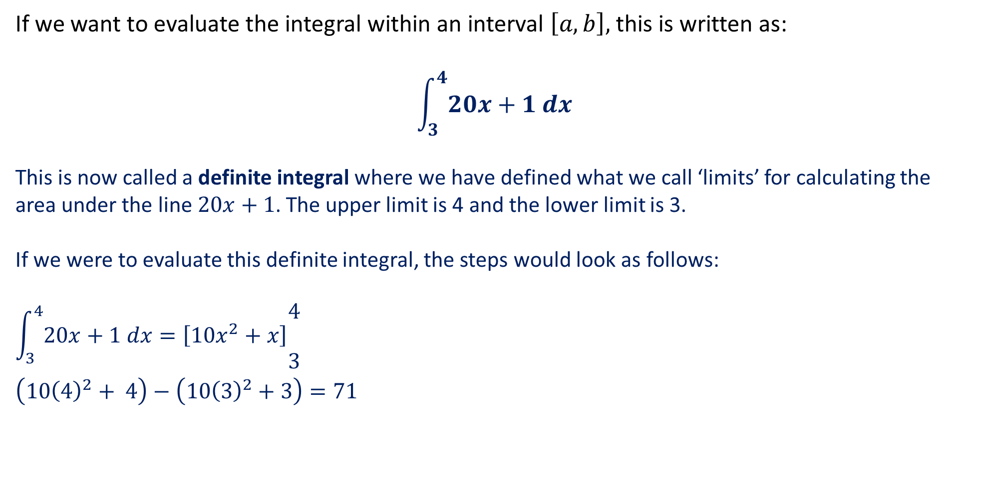
Definite Integrals
If we want to evaluate the integral within an interval $\left[a, b\right],$this is written as:
$$\int_{3}^{4}{20x+1 dx}$$
This is now called a definite integral where we have defined what we call ‘limits’ for calculating the area under the line$20x+1$. The upper limit is 4 and the lower limit is 3.
If we were to evaluate this definite integral, the steps would look as follows:
$$\int_{3}^{4}{20x+1 dx}=\left[10x^{2}+x\right]\begin{matrix}\begin{aligned}4 \\ \end{aligned} \\ 3\end{matrix}$$
$$\left(10{\left(4\right)}^{2}+ 4\right)−\left(10{\left(3\right)}^{2}+3\right)=71$$
NOTE: A constant (+ c) is not needed when you antidifferentiate
the function in a definite integral.
This is because the constant would be cancelled out during the subtraction step anyway, so it’s redundant.

Slide 7
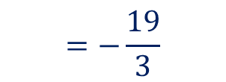
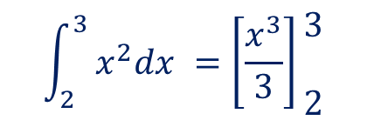
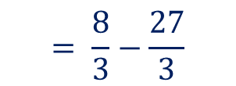
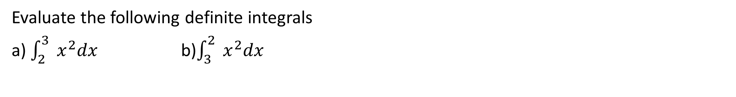
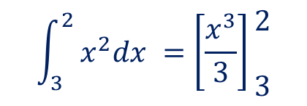

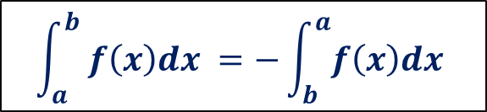
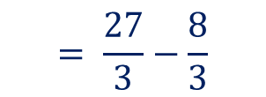
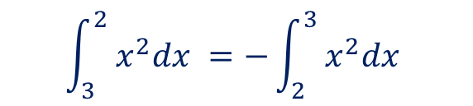
Guided practice
Evaluate the following definite integrals
a) $\int_{2}^{3}{ x^{2}dx }$ b)$\int_{3}^{2}{ x^{2}dx }$
$$\int_{2}^{3}{ x^{2}dx }=\left[\frac{x^{3}}{3}\right]\begin{matrix}\begin{aligned}3 \\ \end{aligned} \\ 2\end{matrix}$$
$$\int_{3}^{2}{ x^{2}dx }=\left[\frac{x^{3}}{3}\right]\begin{matrix}\begin{aligned}2 \\ \end{aligned} \\ 3\end{matrix}$$
$$= \frac{27}{3}−\frac{8}{3}$$
$$= \frac{8}{3}−\frac{27}{3}$$
$$=−\frac{19}{3}$$
$$=\frac{19}{3}$$
$$\int_{3}^{2}{ x^{2}dx }=−\int_{2}^{3}{ x^{2}dx }$$
What do you notice?
$$\int_{a}^{b}{ f\left(x\right)dx }=−\int_{b}^{a}{f\left(x\right)dx }$$

Slide 8
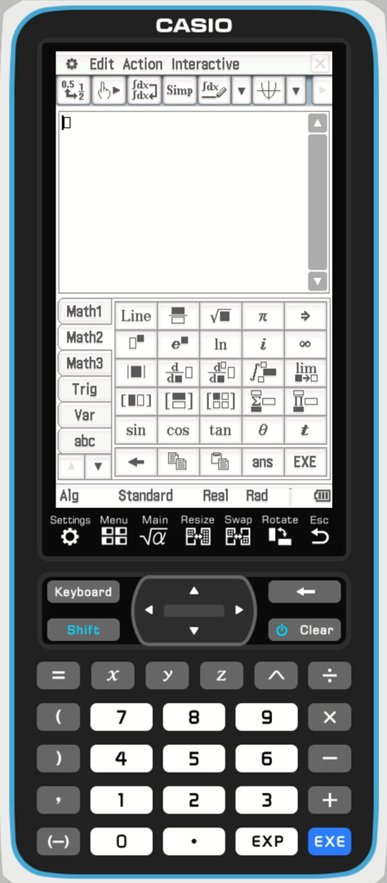
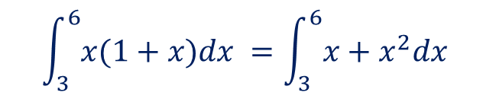

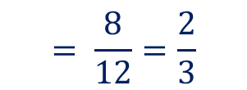
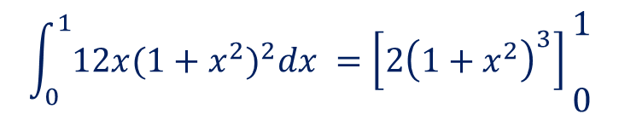
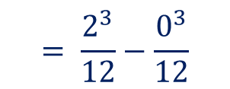
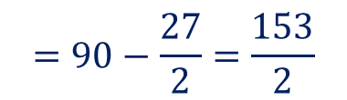
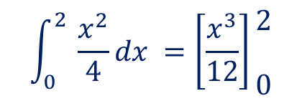
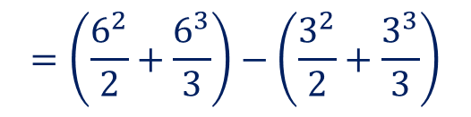
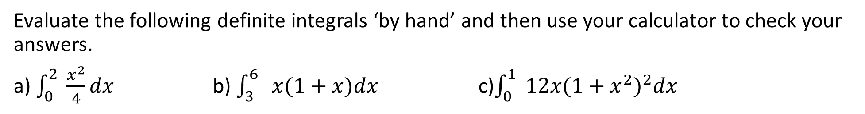
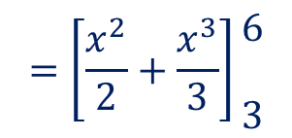

Guided practice
Evaluate the following definite integrals ‘by hand’ and then use your calculator to check your answers.
a) $\int_{0}^{2}{ \frac{x^{2}}{4}dx }$ b) $\int_{3}^{6}{ x(1+x)dx }$ c)$\int_{0}^{1}{ 12x{(1+x^{2})}^{2}dx }$
$$\int_{0}^{2}{ \frac{x^{2}}{4}dx }=\left[\frac{x^{3}}{12}\right]\begin{matrix}\begin{aligned}2 \\ \end{aligned} \\ 0\end{matrix}$$
$$\int_{3}^{6}{x(1+x)dx }=\int_{3}^{6}{x+x^{2}dx }$$
$$\int_{0}^{1}{12x{(1+x^{2})}^{2}dx }=\left[{2\left(1+x^{2}\right)}^{3}\right]\begin{matrix}\begin{aligned}1 \\ \end{aligned} \\ 0\end{matrix}$$
$$=\left[\frac{x^{2}}{2}+\frac{x^{3}}{3}\right]\begin{matrix}\begin{aligned}6 \\ \end{aligned} \\ 3\end{matrix}$$
$$=\left({2\left(1+1^{2}\right)}^{3}\right)−\left({2\left(1+0^{2}\right)}^{3}\right)$$
$$= \frac{2^{3}}{12}−\frac{0^{3}}{12}$$
$$=\left(\frac{6^{2}}{2}+\frac{6^{3}}{3}\right)−\left(\frac{3^{2}}{2}+\frac{3^{3}}{3}\right)$$
$$=16−2=14$$
$$= \frac{8}{12}=\frac{2}{3}$$
$$=90−\frac{27}{2}=\frac{153}{2}$$

Slide 9

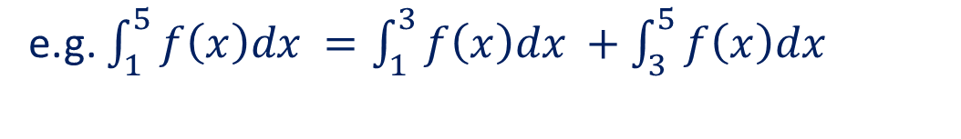
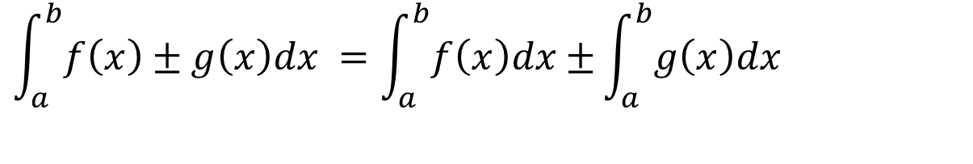
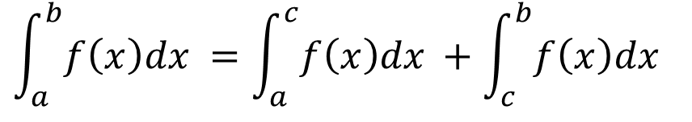
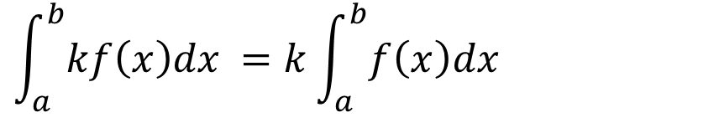
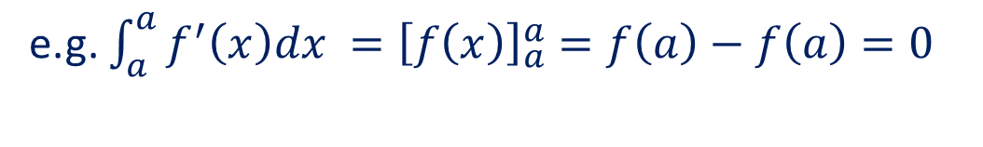

Properties of definite integral
$$\int_{a}^{b}{f\left(x\right)dx }=\int_{a}^{c}{f\left(x\right)dx }+\int_{c}^{b}{f\left(x\right)dx }$$
e.g. $\int_{1}^{5}{f\left(x\right)dx }=\int_{1}^{3}{f\left(x\right)dx }+\int_{3}^{5}{f\left(x\right)dx }$
$$\int_{a}^{a}{f\left(x\right)dx }=0$$
e.g. $\int_{a}^{a}{f^{′}\left(x\right)dx }={\left[f\left(x\right)\right]}_{a}^{a}=f\left(a\right)−f\left(a\right)=0$
$$\int_{a}^{b}{kf\left(x\right)dx }=k\int_{a}^{b}{f\left(x\right)dx }$$
$$\int_{a}^{b}{f\left(x\right)±g\left(x\right)dx }=\int_{a}^{b}{f\left(x\right)dx±}\int_{a}^{b}{g\left(x\right)dx }$$
$$\int_{a}^{b}{ f\left(x\right)dx }=−\int_{b}^{a}{f\left(x\right)dx }$$

Slide 10
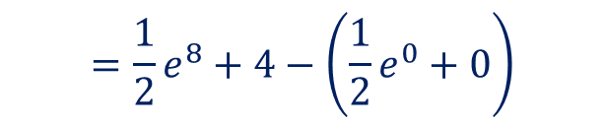

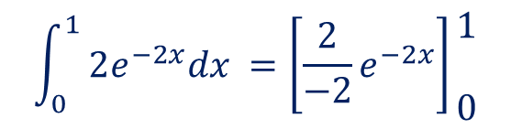












Guided practice
Evaluate the following definite integrals, leaving your answer in exact values
a) $\int_{0}^{1}{2e^{−2x}dx }$ b) $\int_{0}^{4}{e^{2x}+1dx }$ c)$\int_{1}^{4}{ 2x^{\frac{1}{2}}+e^{\frac{x}{2}}dx }$
$$\int_{0}^{1}{ 2e^{−2x}dx }=\left[\frac{2}{−2}e^{−2x}\right]\begin{matrix}\begin{aligned}1 \\ \end{aligned} \\ 0\end{matrix}$$
$$\int_{0}^{4}{ e^{2x}+1dx }=\left[\frac{1}{2}e^{2x}+x\right]\begin{matrix}\begin{aligned}4 \\ \end{aligned} \\ 0\end{matrix}$$
$$\int_{1}^{4}{ {2x^{\frac{1}{2}}+e}^{\frac{x}{2}}dx }=\left[\frac{2x^{\frac{3}{2}}}{\frac{3}{2}}+2e^{\frac{x}{2}}\right]\begin{matrix}\begin{aligned}4 \\ \end{aligned} \\ 1\end{matrix}$$
$$=\left[−e^{−2x}\right]\begin{matrix}\begin{aligned}1 \\ \end{aligned} \\ 0\end{matrix}$$
$$=\frac{1}{2}e^{8}+4−\left(\frac{1}{2}e^{0}+0\right)$$
$$=\left[\frac{4}{3}x^{\frac{3}{2}}+2e^{\frac{x}{2}}\right]\begin{matrix}\begin{aligned}4 \\ \end{aligned} \\ 1\end{matrix}$$
$$=−e^{−2}−\left(−e^{0}\right)$$
$$=\frac{1}{2}e^{8}+4−\frac{1}{2}$$
$$=\frac{4}{3}{\left(4\right)}^{\frac{3}{2}}+2e^{2}−\left(\frac{4}{3}+2e^{\frac{1}{2}}\right)$$
$$=1−e^{−2}$$
$$=\frac{1}{2}e^{8}+\frac{7}{2}$$
$$=\frac{4}{3}(8)+2e^{2}−\left(\frac{4}{3}+2e^{\frac{1}{2}}\right)$$
$$=\frac{1}{2}\left(e^{8}+7\right)$$
$$=\frac{28}{3}+2e^{2}−2e^{\frac{1}{2}}$$

Slide 11






Guided practice
Given that $\int_{0}^{4}{h\left(x\right)dx=5, }$evaluate:
a) $\int_{0}^{4}{h\left(x\right)+3 dx }$ b)$\int_{4}^{0}{h\left(x\right)dx }$
$$\int_{0}^{4}{h\left(x\right)+3 dx }=\int_{0}^{4}{h\left(x\right) dx+\int_{0}^{4}{3 dx }}$$
$$\int_{4}^{0}{h\left(x\right)dx }=−\int_{0}^{4}{h\left(x\right) dx}$$
$$=5+\left[3x\right]\begin{matrix}\begin{aligned}4 \\ \end{aligned} \\ 0\end{matrix}$$
$$=−5$$
$$=5+12=17$$

Slide 12
Independent Practice
Complete Cambridge Ex 6D
Complete Cambridge Ex 6E all except Q5

